Slide 1
CIS 4930/6930-002 Data Visualization
Visual Design
Paul Rosen
Assistant Professor
University of South Florida
slides credits Miriah Meyer (U of Utah), Hanspeter Pfister (Harvard), John Stasko (Georgia Tech), & Josh Levine (U of Arizona)

Slide 2
today . . .
Four Levels of Visualization Design
Tufte’s Principles (Integrity & Design)
Critiques

Slide 3
THE FOUR LEVELS OF VISUALIZATION DESIGN

Slide 4
Munzner’s NESTED MODEL
design model—describes levels of design inherent to, and that should be considered in, the creation of a visualization
Domain Situation
Data & Task Abstraction
Visual Encoding & Interaction
Technique & Algorithm

Slide 5
Munzner’s NESTED MODEL
domain situation—describing a group of target users, their domain of interest, their questions, and their data
Domain Situation
Data & Task Abstraction
Visual Encoding & Interaction
Technique & Algorithm

Slide 6
Munzner’s NESTED MODEL
data/task abstraction—abstracting the specific domain questions and data from the domain-specific form into a generic, computational form
Domain Situation
Data & Task Abstraction
Visual Encoding & Interaction
Technique & Algorithm

Slide 7
Munzner’s NESTED MODEL
visual encoding & interaction—decide on the specific way to create and manipulate the visual representation of the abstraction
Domain Situation
Data & Task Abstraction
Visual Encoding & Interaction
Technique & Algorithm

Slide 8
Munzner’s NESTED MODEL
algorithm—crafting a detailed procedure that allows a computer to automatically and efficiently carry out the desired visualization goal
Domain Situation
Data & Task Abstraction
Visual Encoding & Interaction
Technique & Algorithm

Slide 9
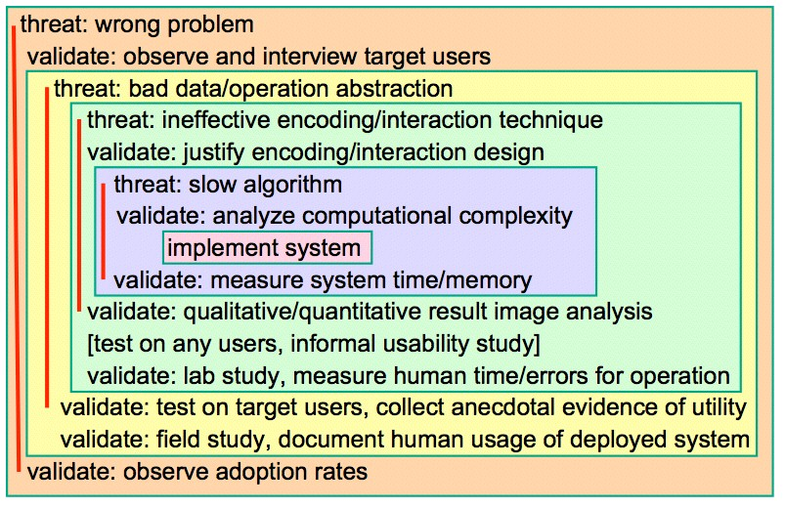
Munzner’s NESTED MODEL

Slide 10
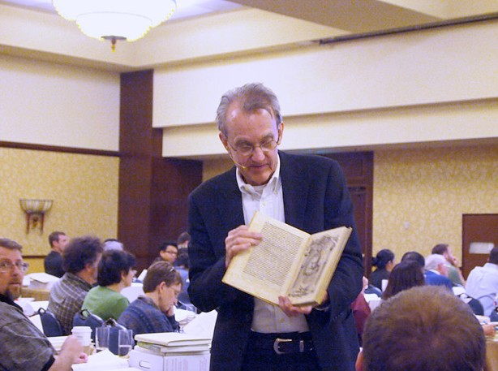
TUFTE
design excellence

Slide 11
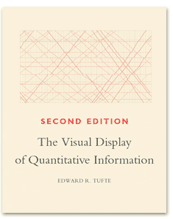
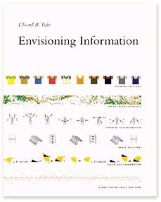
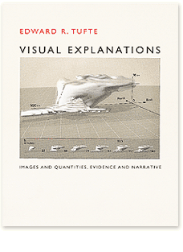


Slide 12
TUFTE’S LESSONS
practice—graphical integrity and excellence
theory—design principles for data graphics

Slide 13
GRAPHICAL INTEGRITY
clear, detailed, and thorough labeling should be used to defeat graphical distortion and ambiguity

Slide 14









MISSING SCALES
$521,943
$397,747
($11,410)
$351,341
$3,594,385
Tufte 2001

Slide 15
MISSING SCALES
$521,943
$397,747
($11,410)
$351,341
$3,594,385
baseline?
Tufte 2001

Slide 16
MISSING SCALES
$521,943
$397,747
($11,410)
$351,341
$3,594,385
baseline?
-$4,200,000
Tufte 2001

Slide 17
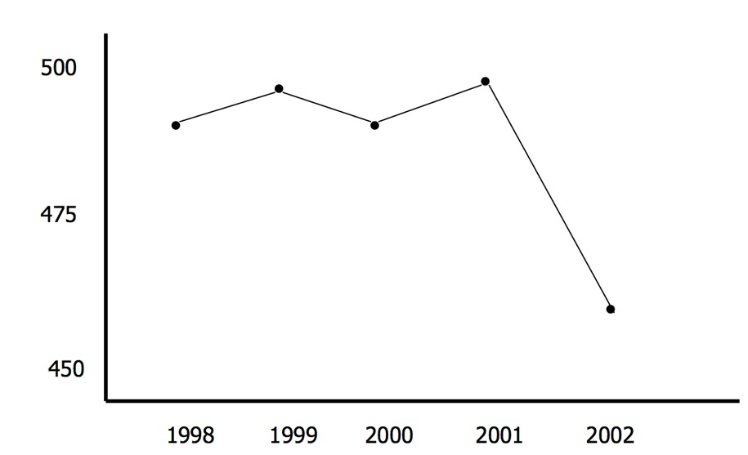
SCALE DISTORTION
volume
year

Slide 18
SCALE DISTORTION
volume
Did the stock market crash?
year

Slide 19
SCALE DISTORTION
scale?
volume
Did the stock market crash?
year

Slide 20
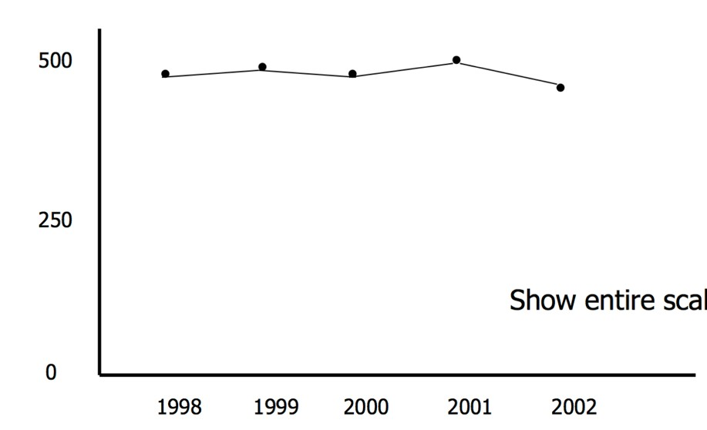
SCALE DISTORTION
volume
Did the stock market crash?
year

Slide 21
SCALE DISTORTION
context?
volume
Did the stock market crash?
year

Slide 22
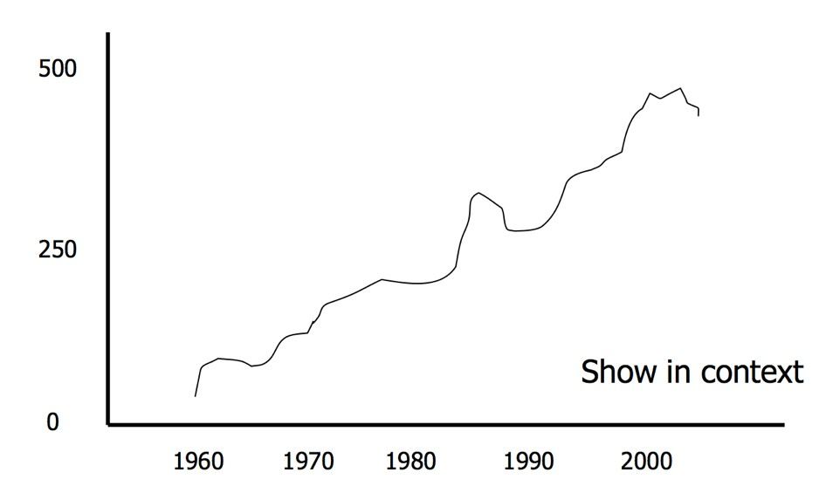
SCALE DISTORTION
volume
Did the stock market crash?
year

Slide 23

SCALE DISTORTION
volume
Did the stock market crash?
year

Slide 24
Tufte’s integrity principles
the representation of numbers, as physically measured on the surface of the graphic itself, should be directly proportional to the numerical quantities represented.
size of effect shown in graphic
The Lie Factor =
size of effect in data

Slide 25
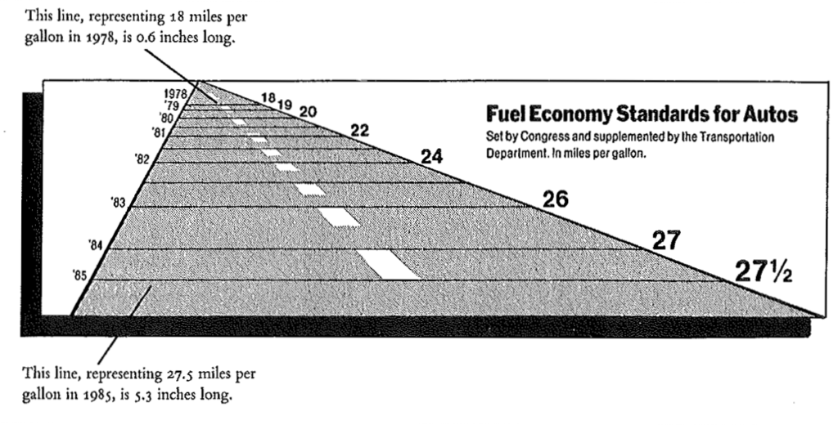
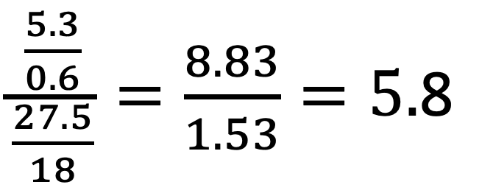
DISTORTION
$\frac{\frac{5.3}{0.6}}{\frac{27.5}{18}}=\frac{8.83}{1.53}=5.$8
Lie factor for the percent increase from 1978 to 1985
Tufte 2001

Slide 26
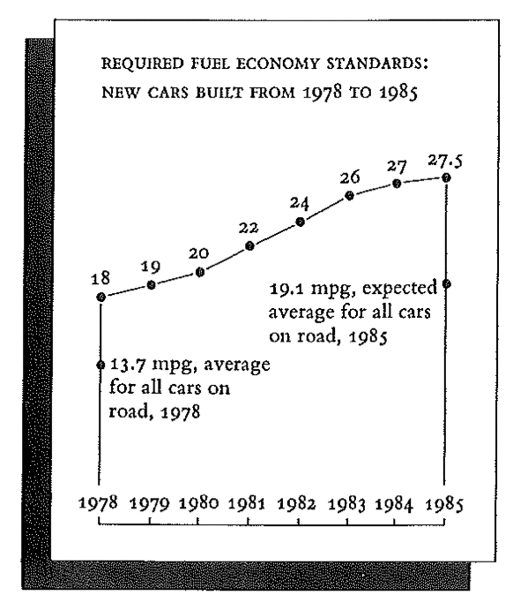
Tufte 2001

Slide 27
Tufte’s integrity principles
show data variation, not design variation

Slide 28
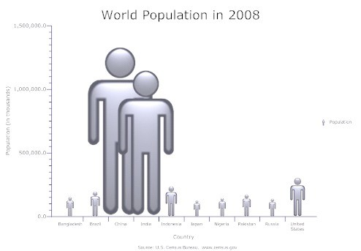
UNINTENDED SIZE CODING
http://peltiertech.com/WordPress/bad-bar-chart-practices-or-send-in-the-clowns/

Slide 29
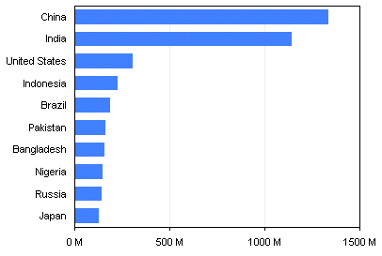
UNINTENDED SIZE CODING
http://peltiertech.com/WordPress/bad-bar-chart-practices-or-send-in-the-clowns/

Slide 30
Tufte’s integrity principles
Graphical excellence is that which
gives the viewer the greatest number of ideas
in the shortest time
with the least ink
in the smallest space
A. Einstein, “An explanation should be as simple as possible, but no simpler.”

Slide 31
DESIGN PRINCIPLES
(or how to achieve integrity and excellence)

Slide 32
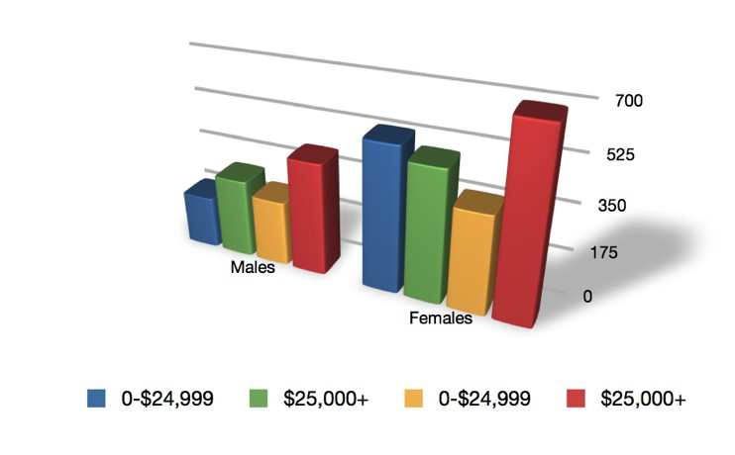
maximize the
Data-ink Ratio =
data-ink
total ink used in graphic
TRIGLYCERIDE LEVEL

Slide 33
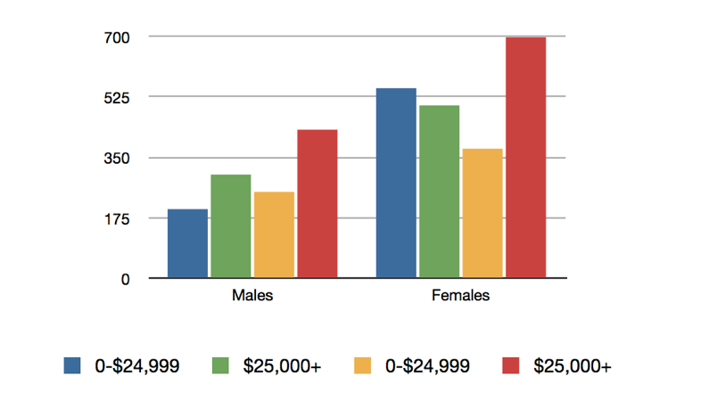
maximize the
Data-ink Ratio =
data-ink
total ink used in graphic
TRIGLYCERIDE LEVEL

Slide 34
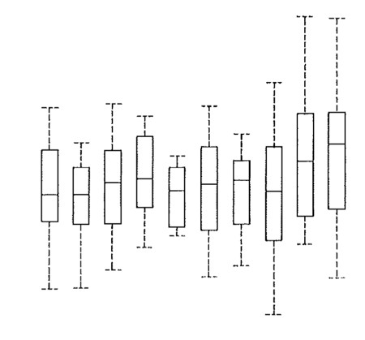
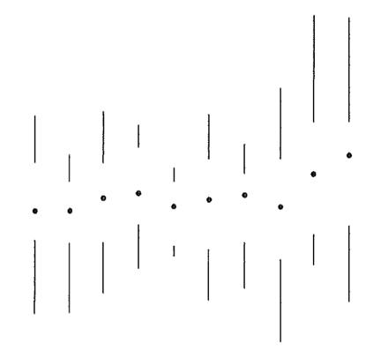
maximize the
Data-ink Ratio =
data-ink
total ink used in graphic
Tufte 2001

Slide 35
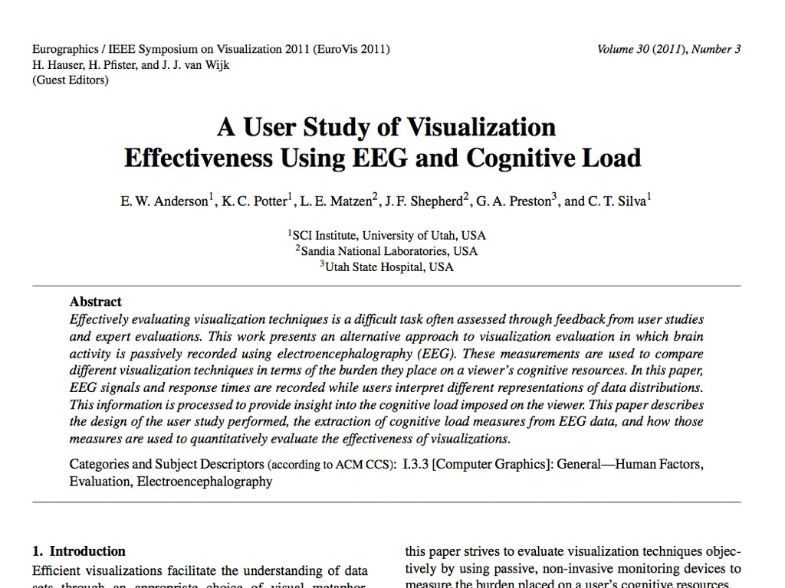
COUNTER-POINT

Slide 36
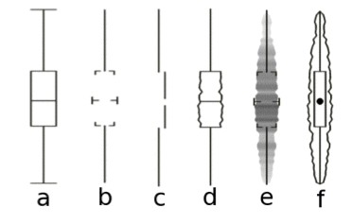
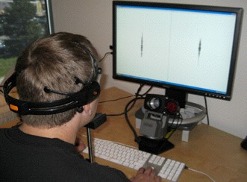
EXPERIMENT
asked participants to choose box plot with largest range from a set
varied representation
measured cognitive load from EEG brain waves

Slide 37
EXPERIMENTAL RESULTS
studies showed that the simplest (highest data-ink ratio) box plot is hardest to interpret
paper focused on cognitive load as an evaluation method

Slide 38
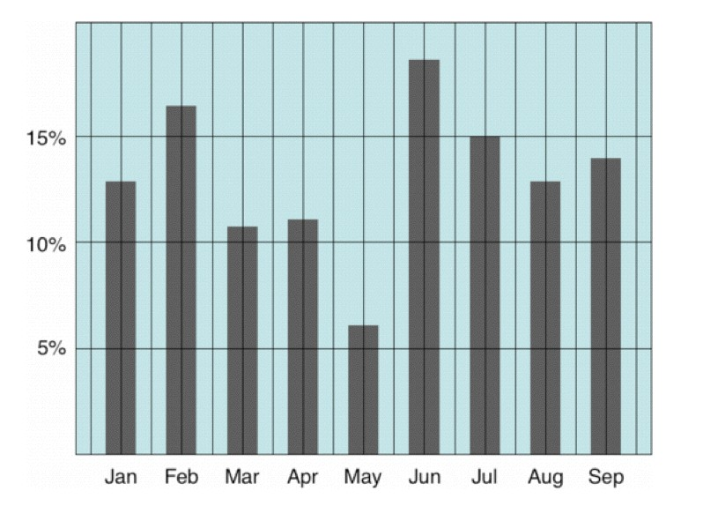
AVOID CHART JUNK

Slide 39
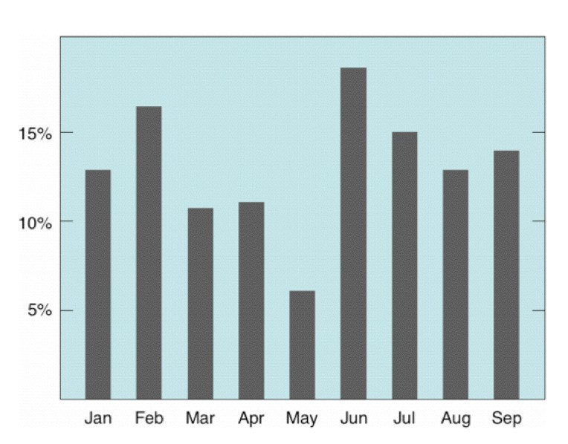
AVOID CHART JUNK

Slide 40
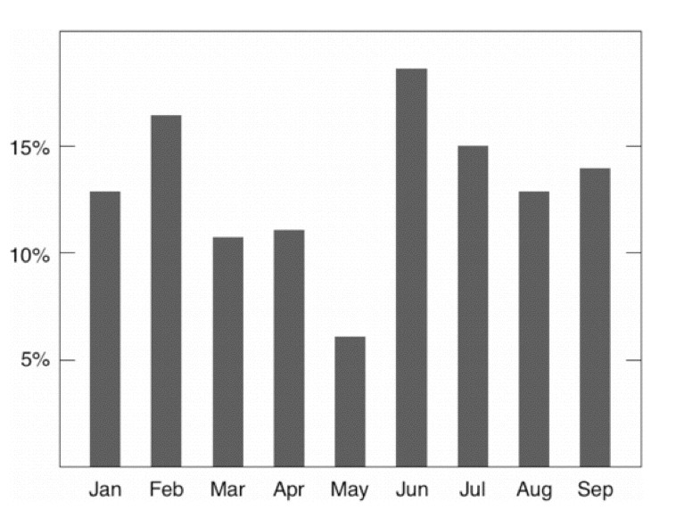
AVOID CHART JUNK

Slide 41
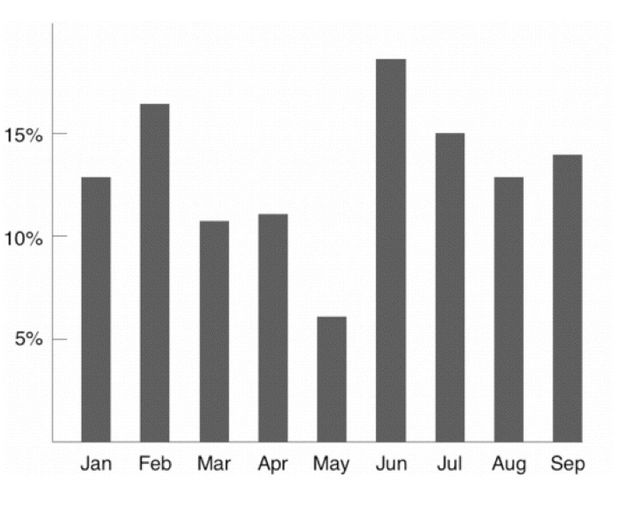
AVOID CHART JUNK

Slide 42
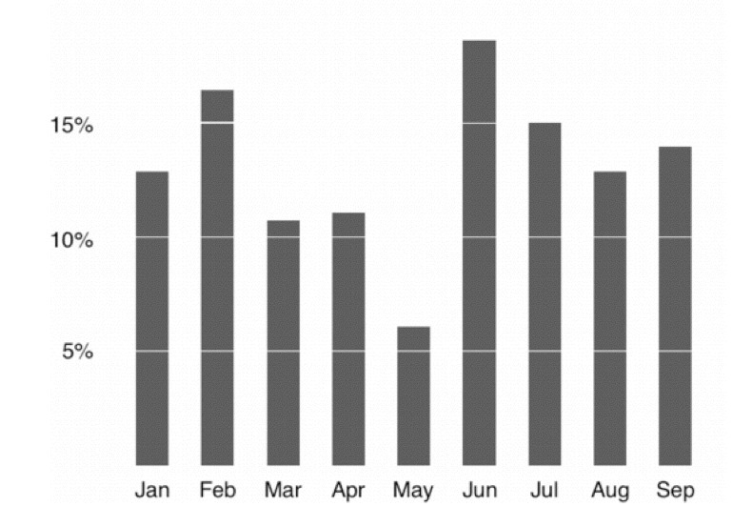
AVOID CHART JUNK

Slide 43
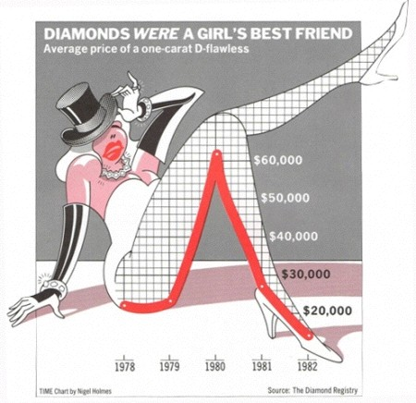
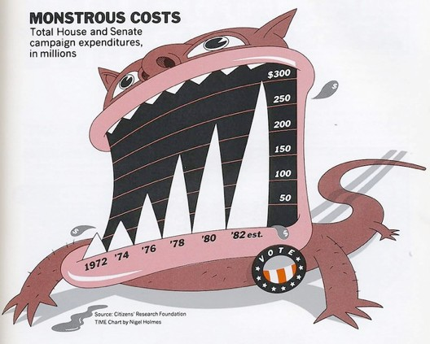
attraction or distraction?
Nigel Holmes,TIME Magazine

Slide 44
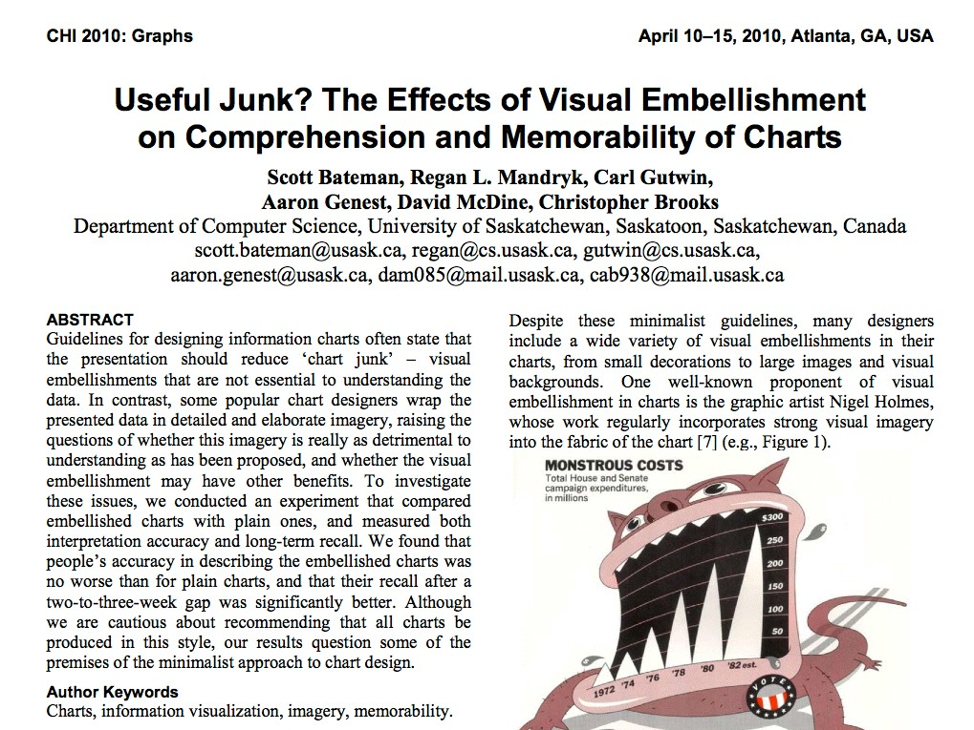
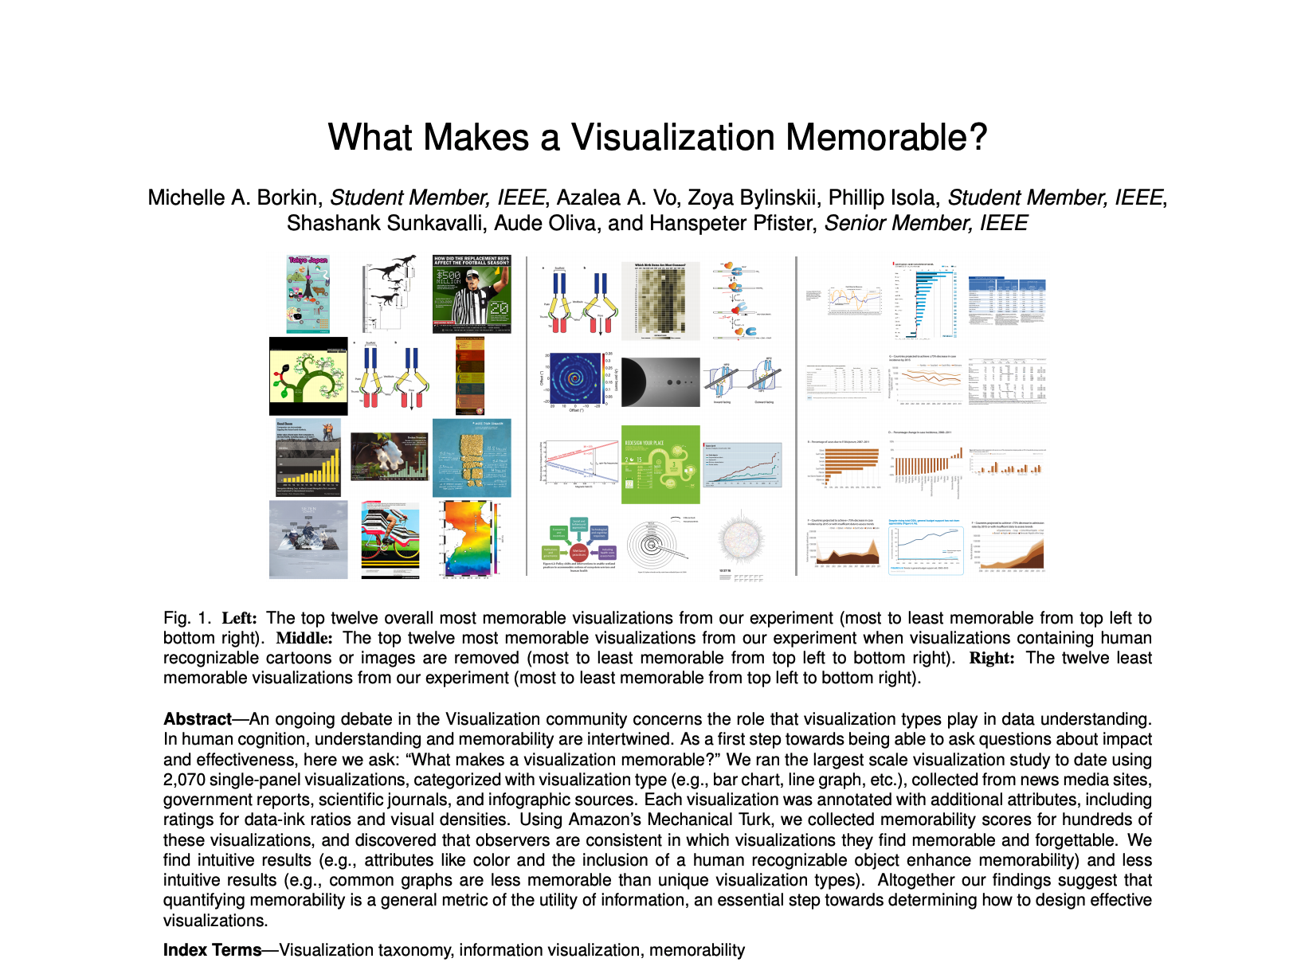
COUNTER-POINTS

Slide 46
EXPERIMENTAL QUESTIONS
do visual embellishments cause comprehension problems?
do embellishments provide additional information that is valuable for the reader?

Slide 47
EXPERIMENTAL RESULTS
No significant difference between plain and embellished charts for interactive interpretation accuracy
No significant difference in recall accuracy after a five-minute gap
56

Slide 48
EXPERIMENTAL RESULTS
Significantly better recall for embellished charts of both the chart topic and the details (categories and trend) after long-term gap (2-3 weeks)
Participants saw value messages in the embellished charts significantly more often than in the plain charts
Participants found the embellished charts more attractive, most enjoyed them, and found that they were easiest and fastest to remember
56

Slide 49
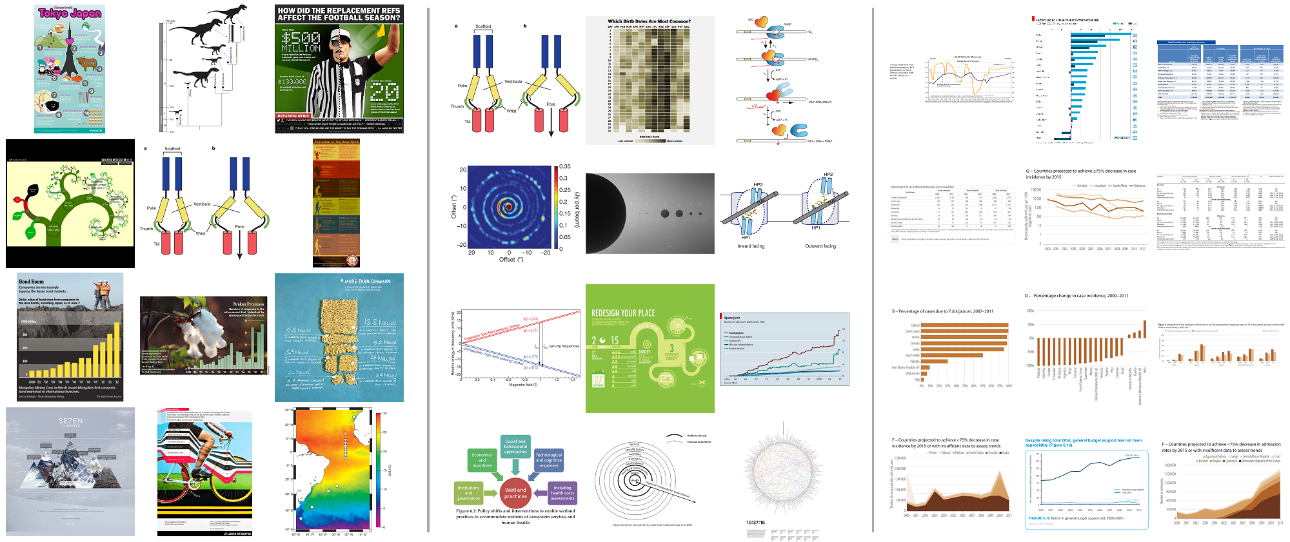
What Makes a Visualization Memorable?
Michelle A. Borkin, Student Member, IEEE, Azalea A. Vo, Zoya Bylinskii, Phillip Isola, Student Member, IEEE, Shashank Sunkavalli, Aude Oliva, and Hanspeter Pfister, Senior Member, IEEE
Fig. 1. Left: The top twelve overall most memorable visualizations from our experiment (most to least memorable from top left to bottom right). Middle: The top twelve most memorable visualizations from our experiment when visualizations containing human recognizable cartoons or images are removed (most to least memorable from top left to bottom right). Right: The twelve least memorable visualizations from our experiment (most to least memorable from top left to bottom right).
Abstract—An ongoing debate in the Visualization community concerns the role that visualization types play in data understanding. In human cognition, understanding and memorability are intertwined. As a first step towards being able to ask questions about impact and effectiveness, here we ask: “What makes a visualization memorable?” We ran the largest scale visualization study to date using 2,070 single-panel visualizations, categorized with visualization type (e.g., bar chart, line graph, etc.), collected from news media sites, government reports, scientific journals, and infographic sources. Each visualization was annotated with additional attributes, including ratings for data-ink ratios and visual densities. Using Amazon’s Mechanical Turk, we collected memorability scores for hundreds of these visualizations, and discovered that observers are consistent in which visualizations they find memorable and forgettable. We find intuitive results (e.g., attributes like color and the inclusion of a human recognizable object enhance memorability) and less intuitive results (e.g., common graphs are less memorable than unique visualization types). Altogether our findings suggest that quantifying memorability is a general metric of the utility of information, an essential step towards determining how to design effective visualizations.
Index Terms—Visualization taxonomy, information visualization, memorability

Slide 50
Results
color and human recognizable objects enhance memorability
common graphs are less memorable than unique visualization types

Slide 51
CHART JUNK? IT DEPENDS
persuasion
memorability
engagement
unbiased analysis
trustworthiness
interpretability
space efficiency
PROS
CONS
59

Slide 52
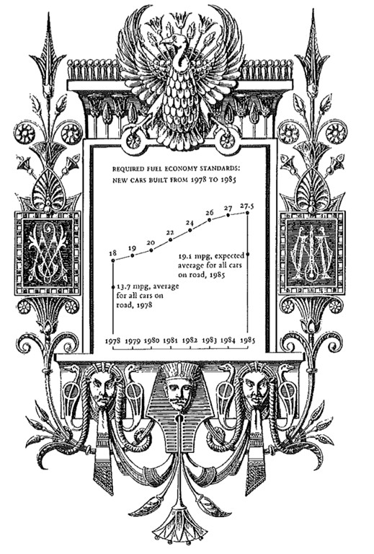
Tufte 2001

Slide 53
maximize the
Data Density =
number of entries in data array
area of data graphic

Slide 54
SHRINK THE GRAPHICS
with small multiples
g1
m2
g4
m3
g5
g6
g7
m4
g13 g12 m7

Slide 55
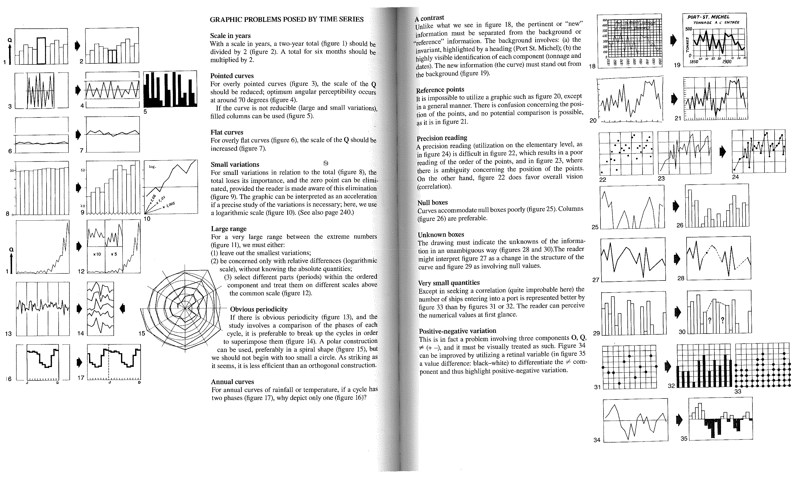
SHRINK THE GRAPHICS
Bertin 1967

Slide 56
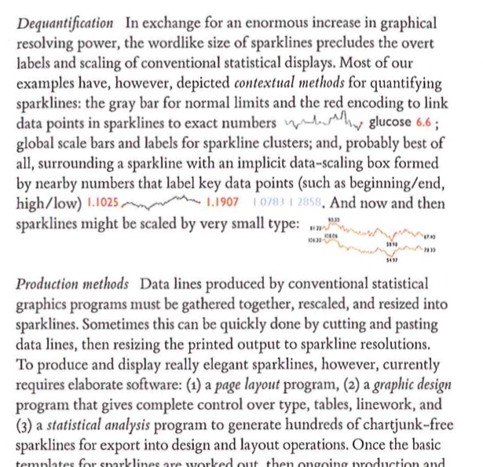
SHRINK THE GRAPHICS
with sparklines
Tufte 2006

Slide 57
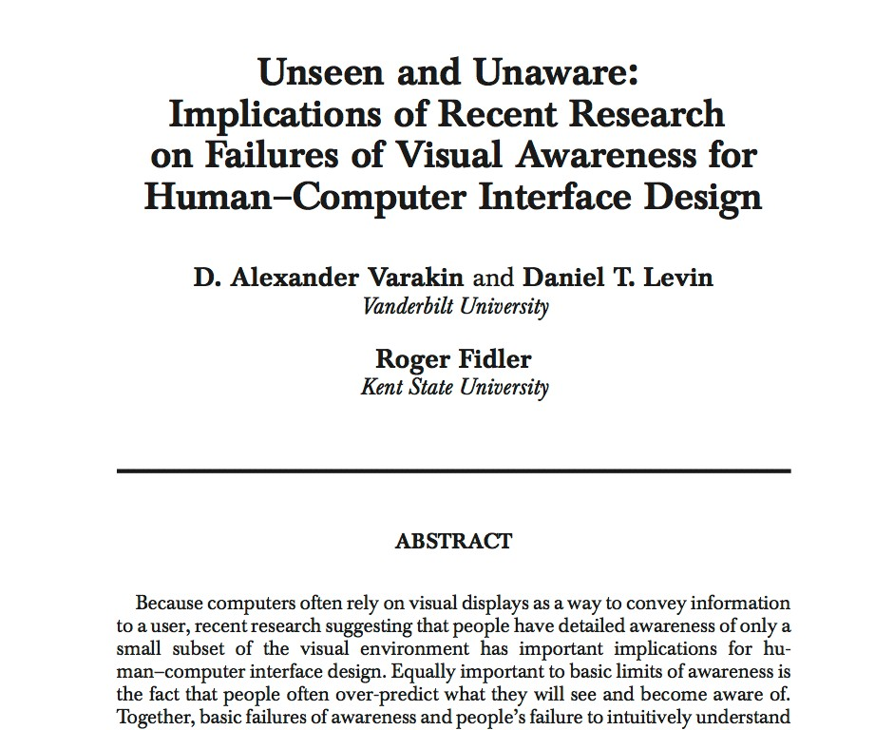
COUNTER-POINT

Slide 58
ILLUSIONS OF VISUAL BANDWIDTH
people over-predict what they will see and become aware of

Slide 59
overestimate of breadth
belief that viewers can take in all (or most) of the details of a scene at once
adding extra visual features makes it harder to find specifics bits of information
74

Slide 60
overestimate of countenance
belief that user will attend to a higher proportion of the display than they do
users typically have expectations about where in a display to look
74

Slide 61
overestimate of depth
belief that attending to an object leads to more complete and deep understanding than is the case
74

Slide 62
Tufte’s design principles
maximize the data-ink ratio
avoid chart junk (sometimes)
use multifunctioning elements
layer information
maximize the data density
shrink the graphics
maximize the amount of data shown (sometimes)

Slide 63
DESIGN CRITIQUES

Slide 64
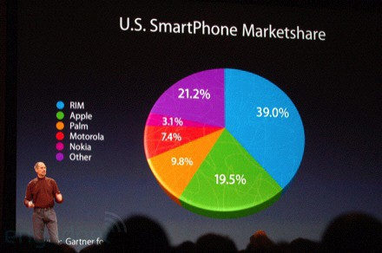
http://www.guardian.co.uk/techhnology/blog/2008/jan/21/liesdamnliesandstevejobs

Slide 65
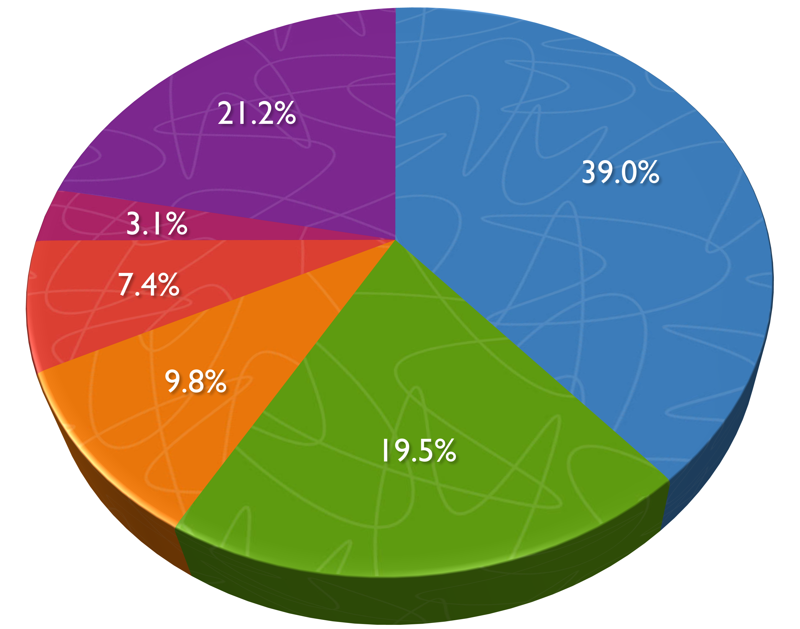






U.S. SmartPhone Marketshare
RIM
Apple Palm Motorola Nokia Other

Slide 66












U.S. SmartPhone Marketshare
21.2%
39.0%
RIM
Apple Palm Motorola Nokia Other
3.1%
7.4%
9.8%
19.5%

Slide 67






U.S. SmartPhone Marketshare
40%
39.0
30%
20%
21.2
19.5
10%
9.8
7.4
3.1
0%
RIM
Other
Apple
Palm
Motorola
Nokia

Slide 68
Recommended Reading
Visualization Analysis & Design: Chapter 4 (pp. 66-93)
The Visual Display of Quantitative Information: all

